Slide 1

Respiratory Health
Alex Mariakakis
University of Toronto
Department of Computer Science

Slide 2
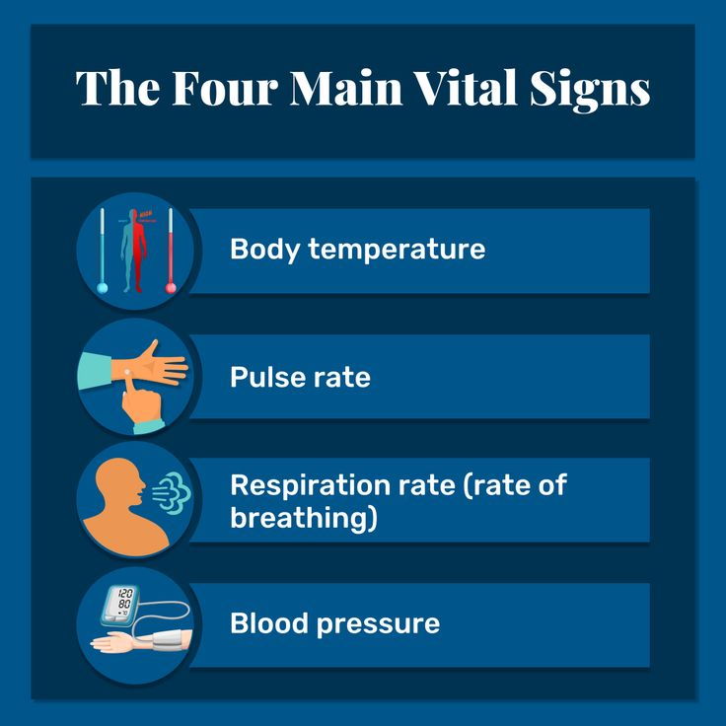
What Are Vital Signs?
Vital signs are measurements of physiological functioning that indicate the overall health status of a person
There are four “main” vital signs, but some have suggested extending the list:
5th: Pain
6th: Gait speed

Slide 3
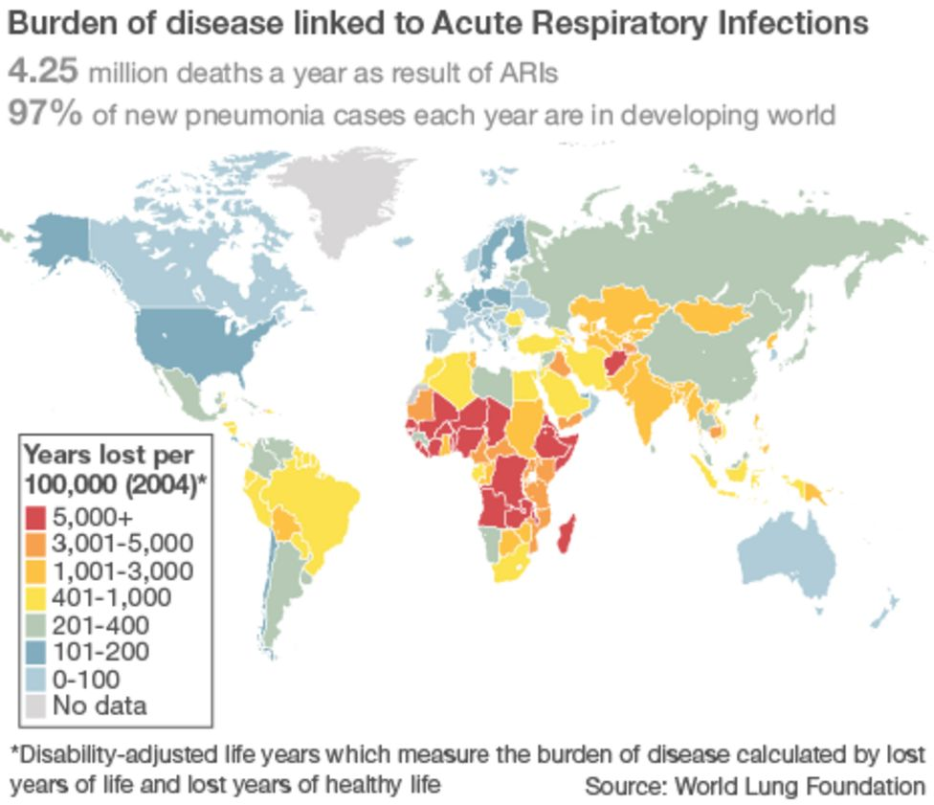
Why Else Do We Care About Respiratory Health?
Before the pandemic, three respiratory diseases accounted for the top ten causes of death worldwide
Chronic obstructive pulmonary disease (COPD): Kills 3.2 million people every year
Pneumonia: A leading cause of death among children < 5 years old and adults > 65 years old
Lung cancer: One of the deadliest forms of cancer (10–20% survival rate)
Other respiratory diseases include asthma, tuberculosis, whooping cough (pertussis), and COVID-19

Slide 4
What Can We Measure About Respiratory Health?
Measure | Traditional Sensor | Relevant Features
Respiration rate | Chest strap | Breaths per minute
Cough characteristics | Microphone | Cough rate, productive (wet) vs. unproductive (dry)
Speech characteristics | Microphone | Speaking rate, pitch, loudness
Spirometry | Spirometer | Flow-volume curve, FEV1, FVC, PEF

Slide 5
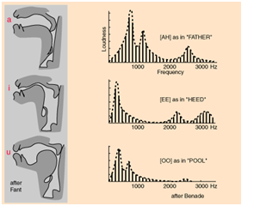
Speech In More Detail
Respiratory illnesses influence our airways, and we use our airways to produce speech
Lots of different categories and terms used to describe speech features
Time domain: Speaking rate, loudness
Frequency domain: Pitch, formant frequencies, MFCCs
Prosodic: Speaking rate, loudness, pitch
Spectral: Formant frequencies, MFCCs
MFCCs: Mel-frequency cepstral coefficients

Slide 6
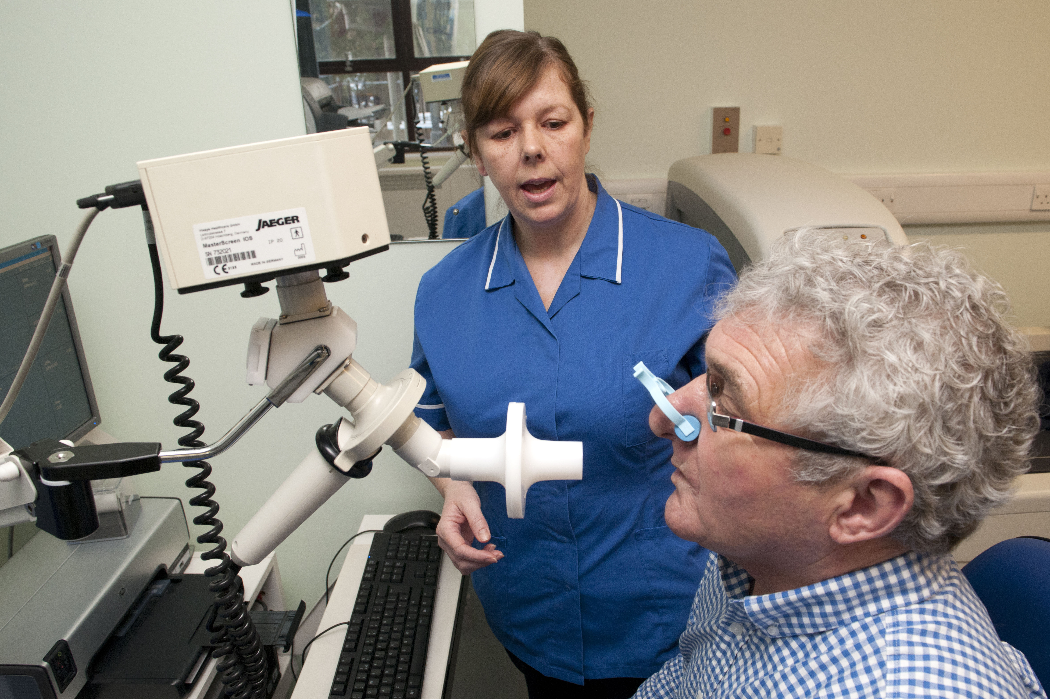
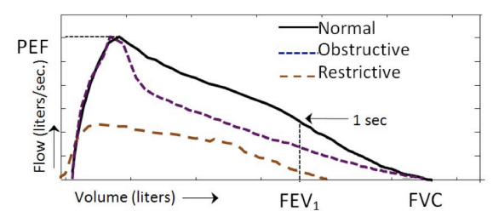
Spirometry In More Detail
Requires a patient to exhale as much air out as quickly as possible through a tube
This effort is non-trivial and often requires coaching
Flow-volume curve provides lots of useful information
PEF: Peak expiratory flow
FEV1: Forced expiratory volume in 1 second
FVC: Forced vital capacity
FEV1/FVC

Slide 7
Resources
Global Impact of Respiratory Disease (Levine and Marciniuk ‘22)

